Slide 1
AI Adoption Analysis
Trolley Logistics LLC
(Ryan Shihabi and Tiffany Le)

Slide 2
Questions
Can technology commodity prices be correlated to the recent mentions of AI?
What types of ML tools are being developed?

Slide 3
Can technology commodity prices be correlated to the recent mentions of AI?

Slide 4
Data
Company Keynote Transcripts
Nvidia GTC
Google I/O
Apple WWDC
Computer and Electronic Product Manufacturing Industry Index (PCU)
Application Software Publishing Commodity Index (WPU)

Slide 5
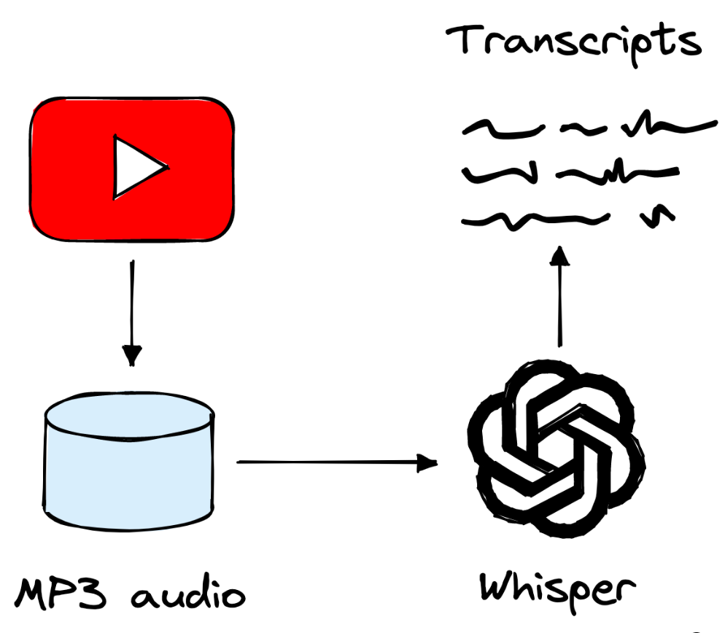
Transcript Collection

Slide 6
Data Cleaning
Mentions
Ensuring all mention counts were entire words
Dates
Converted to DateTime format

Slide 7
Keyword Mentions
Tracking two key phrases in transcripts
Artificial Intelligence (AI)
Machine Learning (ML)
Graphics Processing Unit (GPU)

Slide 8
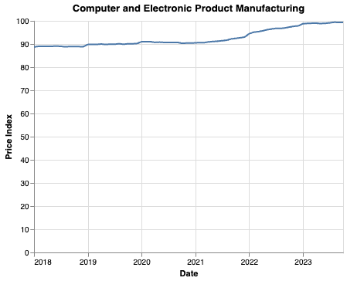
Computer and Electronic Product Manufacturing Industry Index (PCU)

Slide 9
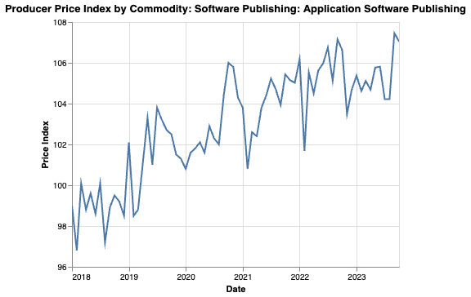
Application Software Publishing Commodity Index (WPU)

Slide 10
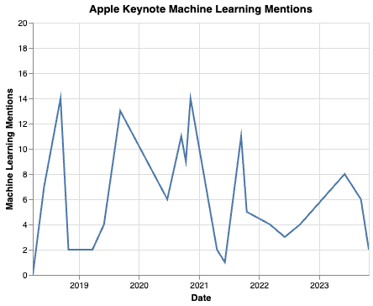
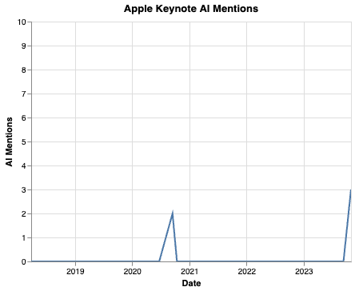
Apple Mentions

Slide 11
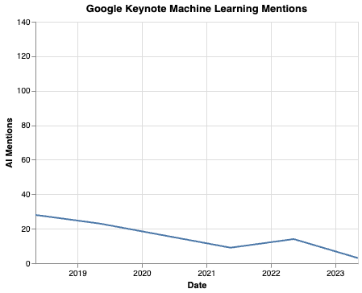
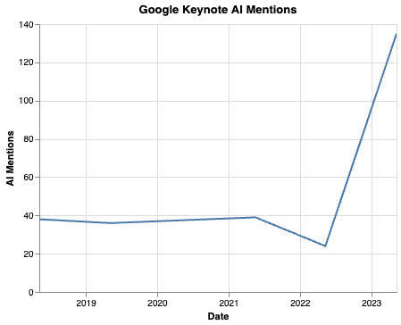
Google

Slide 12
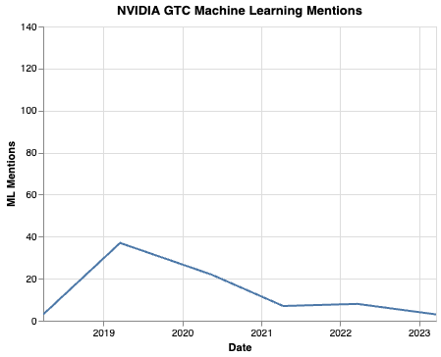
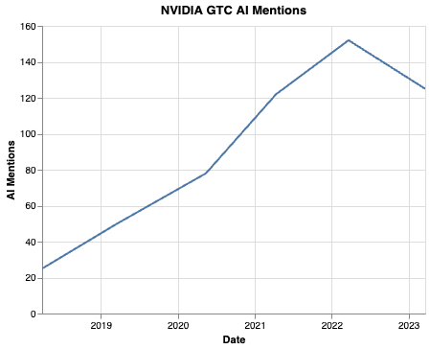
Nvidia

Slide 13
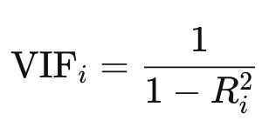
Index and Mention Collinearity
Variance Inflation Factor (VIF)
VIF equal to 1: variables are not correlated
VIF between 1 and 5: variables are moderately correlated
VIF greater than 5: variables are highly correlated

Slide 14
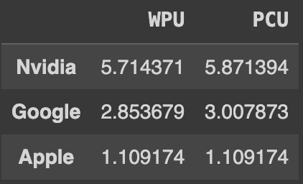
VIF Index and Mentions

Slide 15
VIF Index and Mentions

Slide 16
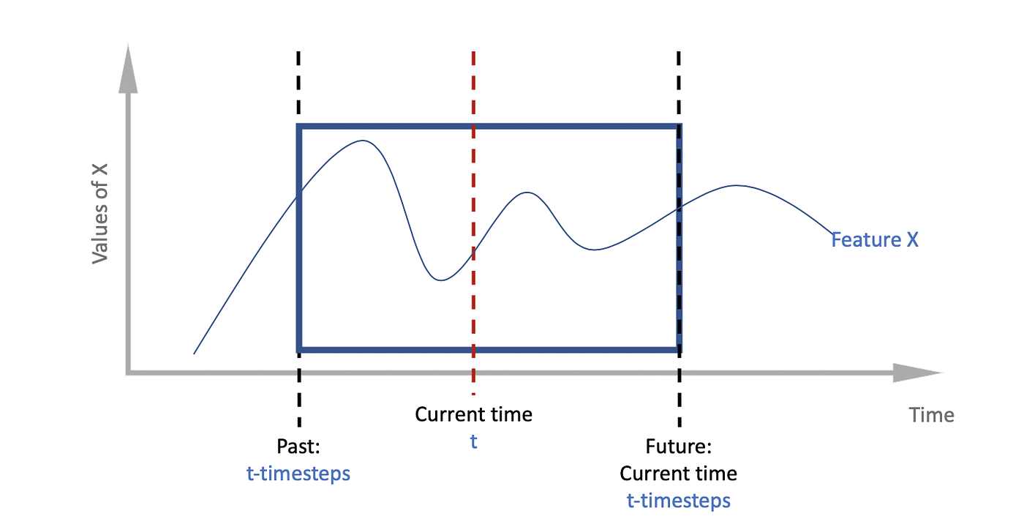
Predicting Prices
LSTM Model

Slide 17
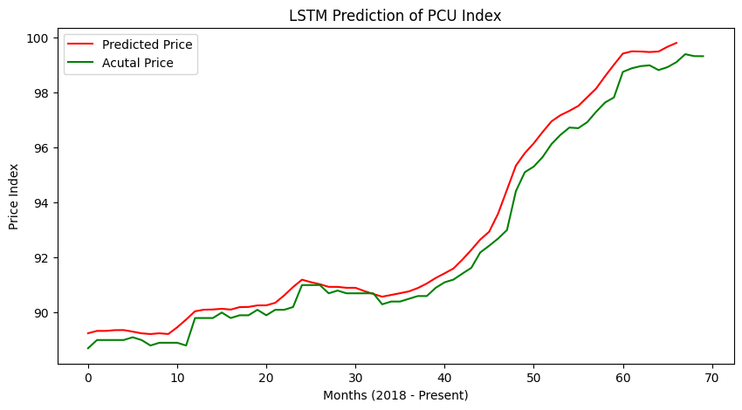

Slide 18
Projected Three Month Price
Projected Index Price: 100.48
Current Price: 99.33
% Change: 1.16%
Train RMSE: 0.0019611173775047064

Slide 19
Letting the Data Speak
We can use the same model that we used to predict price on words
The model will look over our transcripts and tell us what word should come next

Slide 20
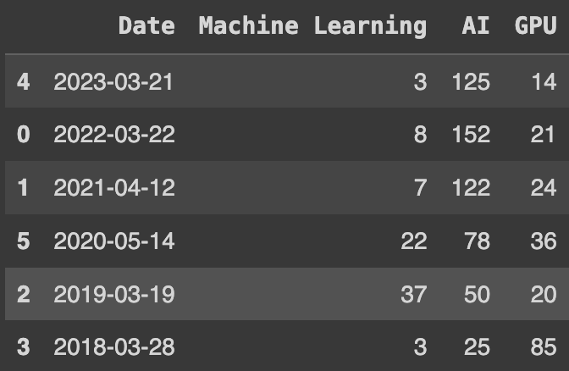
2018 Nvidia Transcript

Slide 21
2018 Nvidia Transcript

Slide 22
Concluding Points
Nvidia GTC drives the market when it comes to hardware commodities
Google I/O has shifted its direction greatly towards AI adoption
Apple is starting to dive back into AI to enhance their devices
More data is needed to create model-based insight
LSTM not the optimal choice
GPT and other transformers for self-attention

Slide 23
What types of ML tools are being developed?

Slide 24
Question 2 Data
Artificial Intelligence Tools 2023
Variables: AI Tool Name, Description, Free/Paid/Other, Useable For, Charges, Review, Tool Link, Major Category
Notes:
Dataset: Has information/insights on the types of AI Tools that are currently available to the public. Insights such as the tool’s use, its cost, and if the tool’s cost is similar to a subscription plan

Slide 25
Data Cleaning
Dropping all missing values (from applicable features)
Dropping only values that will deter from the prediction

Slide 26
Feature Engineering
Charges
Two new variables
charge_frequency
charge_amount
Input Missing Values for “Charge Amount”
All NaN values = 0

Slide 27
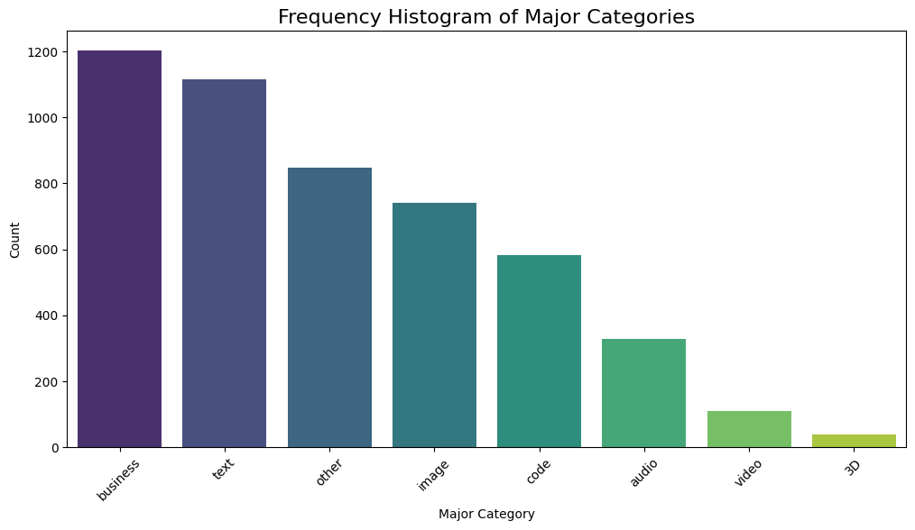
AI Tools’ Categories

Slide 28
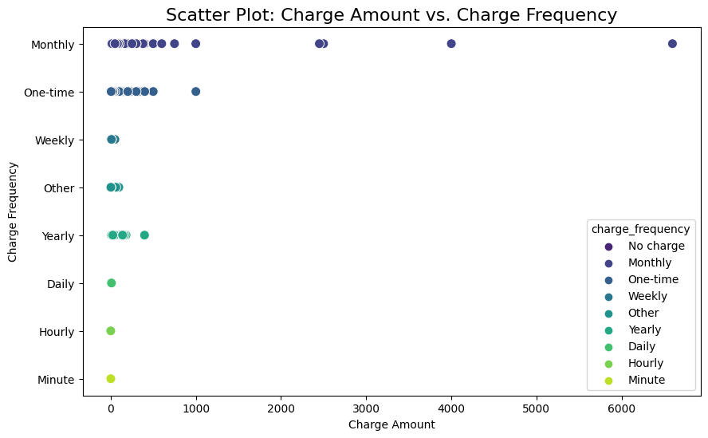
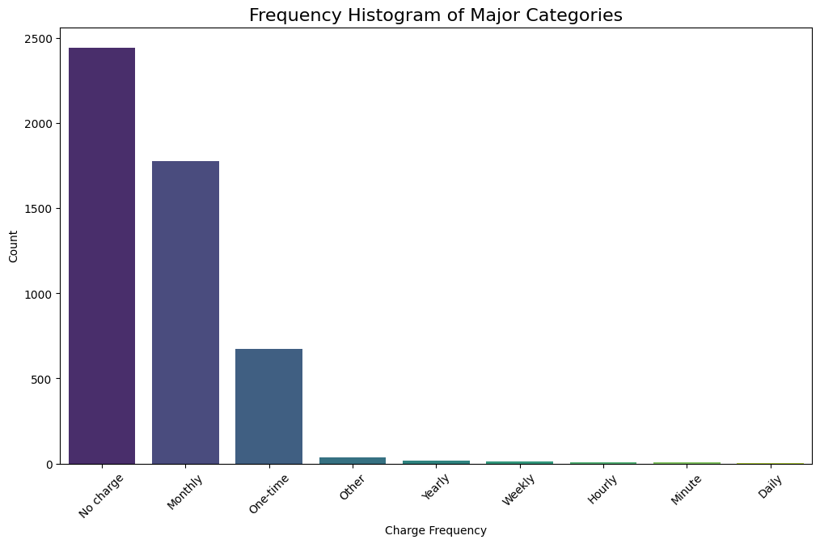
Costs & Its Frequencies
Charge Frequency

Slide 29
AI Tools (Original Dataset) vs AI “Top Three” Tools (Subset Dataset)
Charge Frequencyx

Slide 30
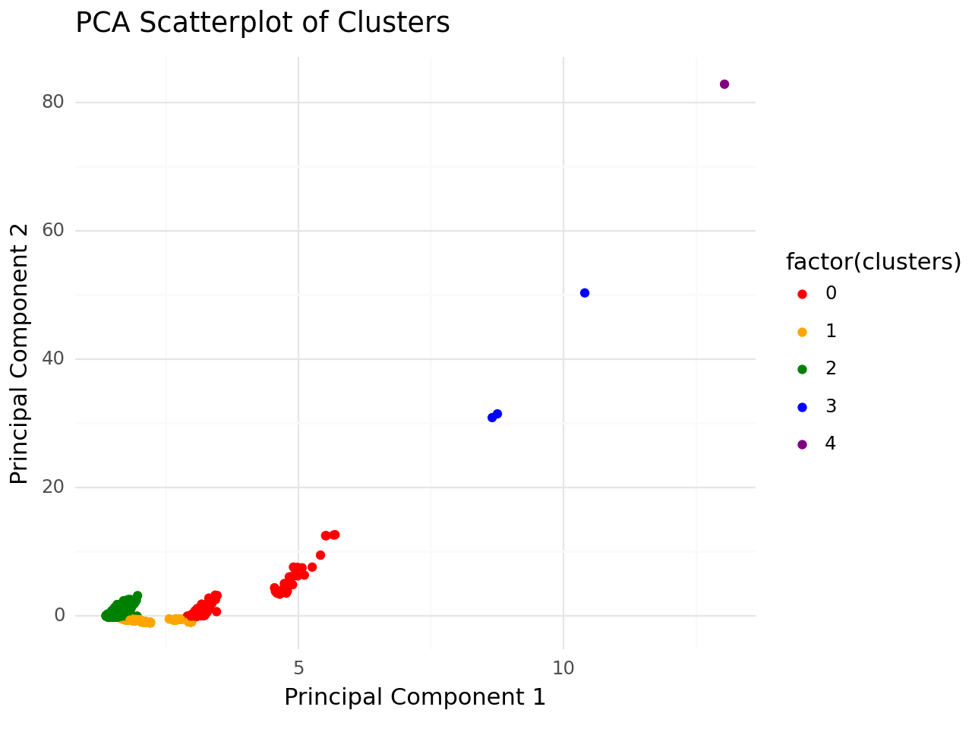
Clustering - KMeans
Notes:
k-means clustering tries to group similar kinds of items in form of clusters. It finds the similarity between the items and groups them into the clusters.

Slide 31
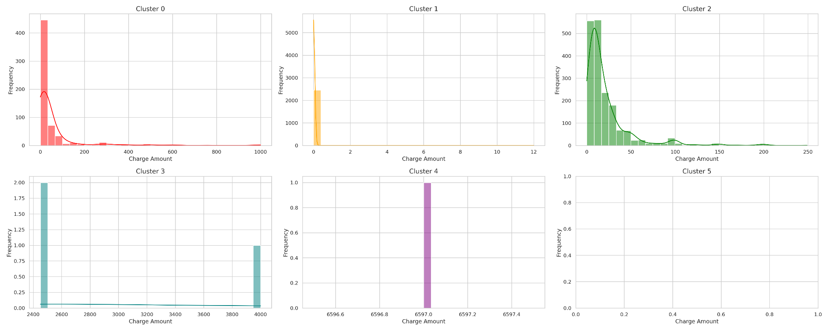
“Charge Amount” Distribution Amongst Clusters 0 & 1

Slide 32
“Charge Amount” Distribution Amongst Clusters 2 & 3

Slide 33
“Charge Amount” Distribution Amongst Cluster 4

Slide 34
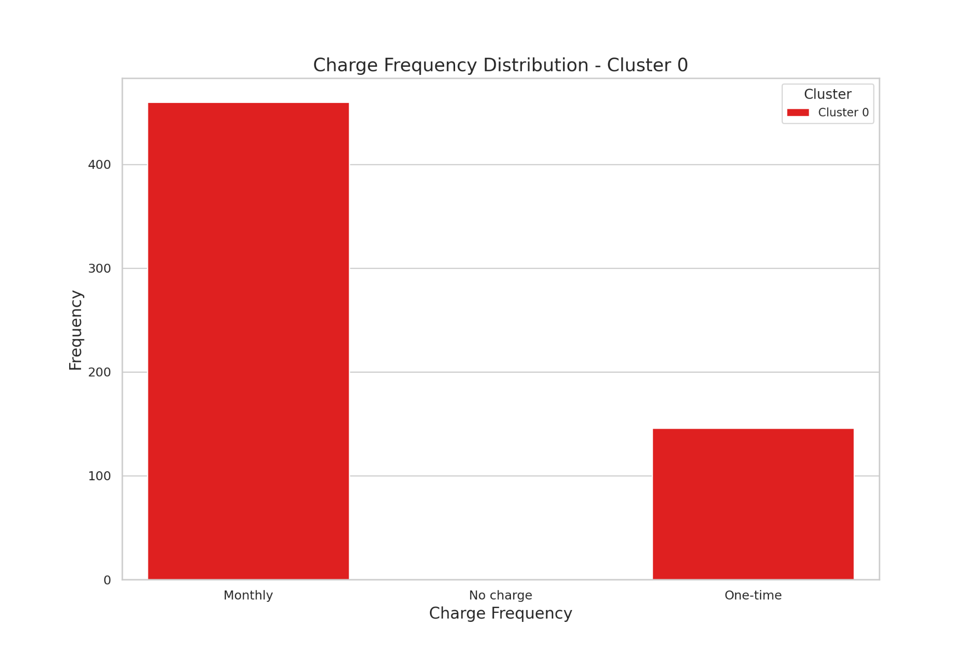
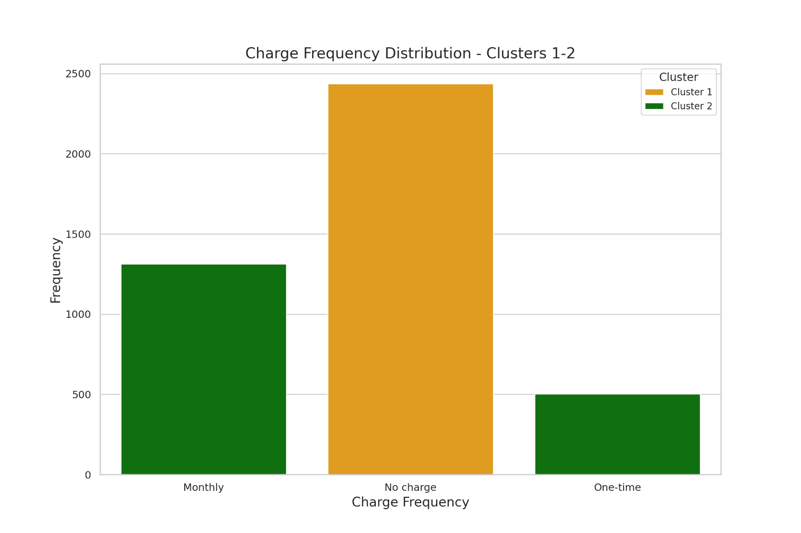
“Charge Frequency” Distribution Amongst Clusters 0, 1, 2

Slide 35
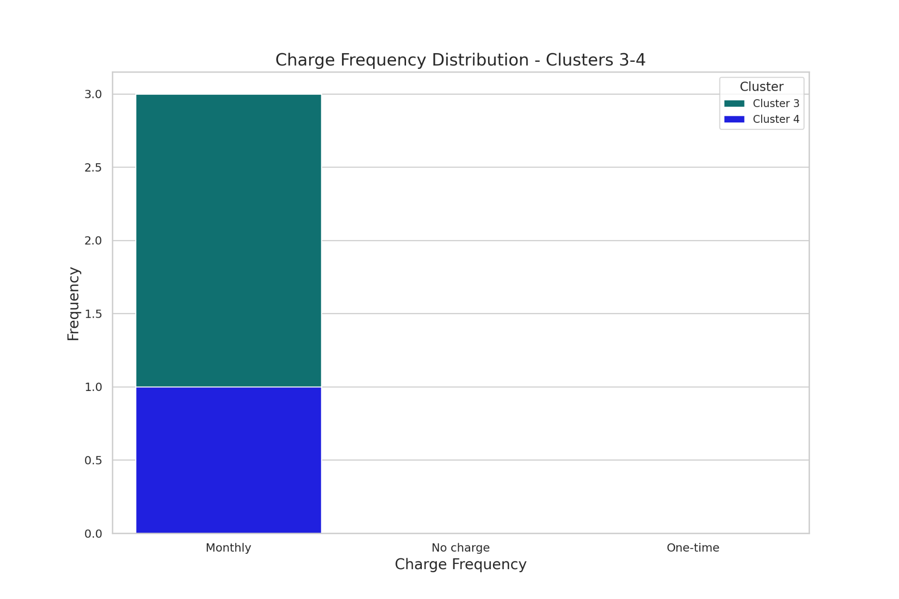
“Charge Frequency” Distribution Amongst Clusters 3, 4

Slide 36
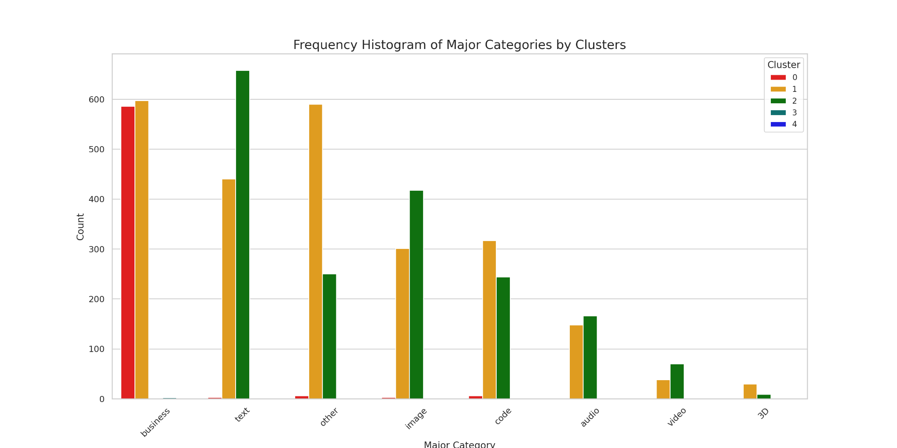
“Major Categories” Distribution Amongst Clusters

Slide 37
Predicting “Charge Amount”
RandomForestRegressor() Model
Performance Metrics
Mean Squared Error (MSE) ~15,280
How close our predictions are to the actual value
Mean Absolute Error (MAE) ~ 19.46
Average magnitude of errors
Mean Absolute Percentage Error (MAPE) ~826,006,337,922,890.6% means
Average % that our predictions deviate from the actual value
R-squared (R2) ~0.10
How much of the variability is explained

Slide 38
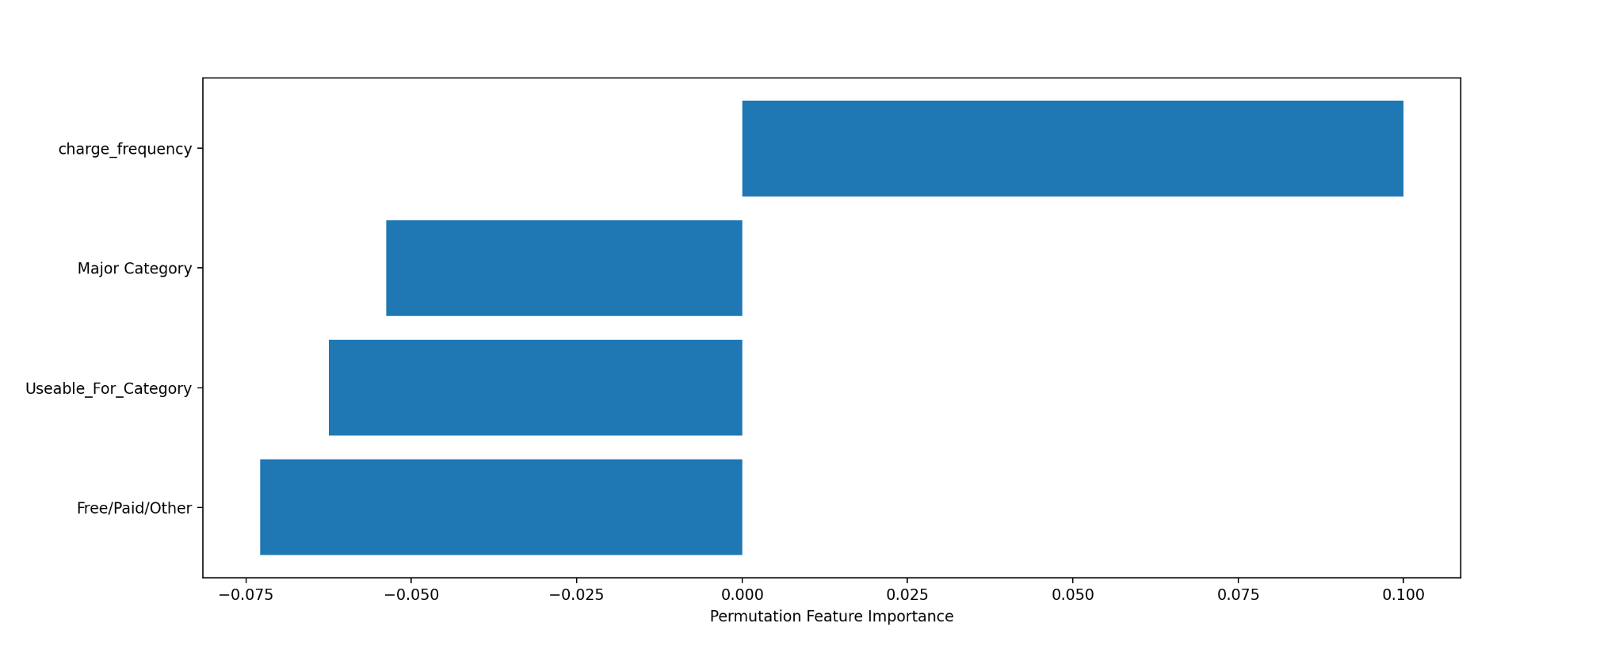
Importance of the Features
Notes:
PFI
observe the change in a model's performance (e.g., accuracy) as we randomly shuffle each feature's values
Positive Values
Shuffling leads to a decrease in model performance
Negative Values
increase in model performance

Slide 39
Classifying “Charge Frequency”
RandomForestClassifier() Model
Performance Metrics
Train Acc ~ 91%
How often is the model predicting correctly?
Train Precision: 92%
How many of the predicted positives are correct?
Train Recall ~91%
How often is the model correct for positive cases?
Train F1 ~ 89%
Combination of the Recall and Precision score of a model

Slide 40
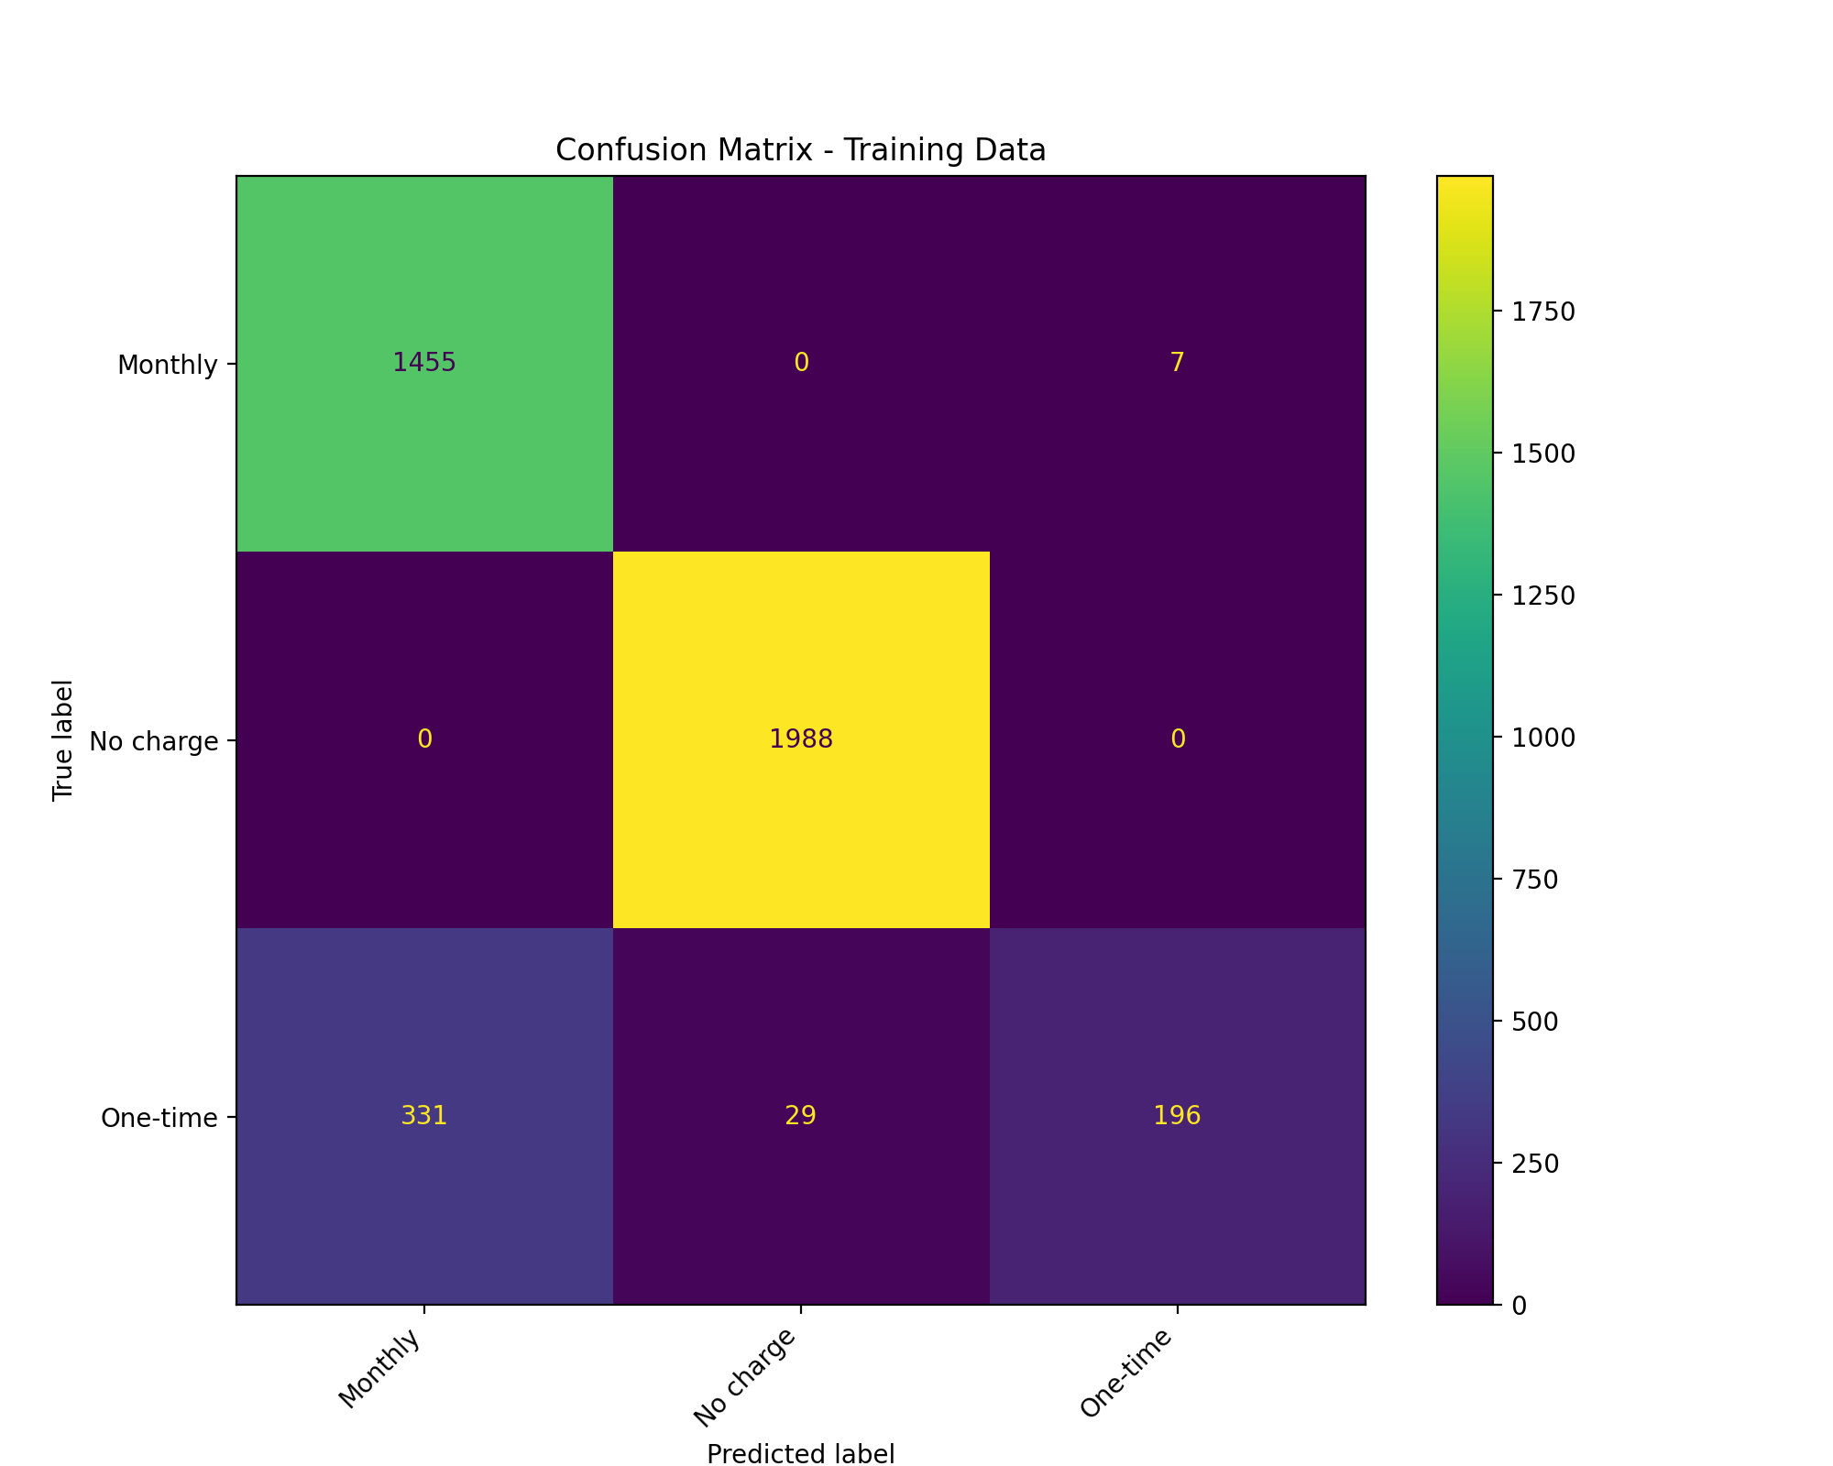

“Charge Frequency” Prediction Accuracy

Slide 41
Concluding Points on ML Tools
Builds off one another
How they present themselves to the public
Designed to be Short Term, Low Commitment, Low Risk
Introduce AI to a broader demographic
Minimize the decision making on consumers (renewing subscription plans)
Increasing customer retention durations
Mostly made for business and text purposes

Slide 42
Thank you!

